Slide 1
Understanding encapsulation
Ronnie Holm
Lecture 3

Slide 2

Agenda
Pillar of object orientation
Language constructs supporting pillar

Slide 3
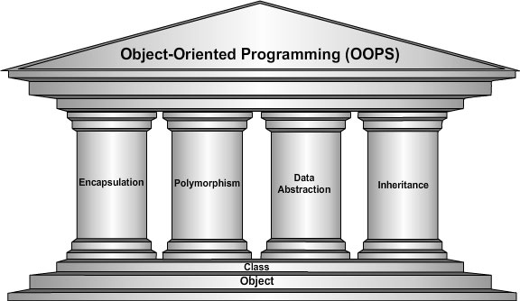
Pillars of OOP
Notes:
- OO may be partially simulated in non-OO languages
- C doesn’t support inheritance
- Only languages that support all four pillars are considered real OO languages
- Sometimes data abstraction is absorbed into other pillars

Slide 4
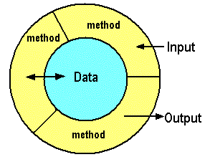
Encapsulation
Keeps each class self-contained
Public interface vs. private implementation
Changing public interface means notifying clients
Internal details known only to class
Notes:
- Change the implementation details of one class without affecting any other class
- Public interface and pre- and postconditions
- Methods act as intermediaries for retrieving or modifying the data they control
- Methods will typically include safeguards specific to types of contained data
- Sinus method: Provide angle as argument - Internally have a table of lookup-values or actual formula

Slide 5
Inheritance
Derived inherits methods/data from parent
Enables reuse of data and code
”is-a” vs. ”has-a” relationships
Control
Car
Button
ListBox
GridView
Wheel
Engine
LinkButton
Notes:
- Often confused as a way to reuse code which isn’t a good practice
- Control data: color, size, location
- Control methods: draw
- Inheritance for implementation reuse leads to high coupling - Only re-use by re-using the class hierarchy upwards
- Classes vs. interfaces
- Re-usability of code is better achieved through composition - Interfaces allow composition to support polymorphic behavior - Class can only inherit from one type, but can implement multiple interfaces - Business-domain classes may all be base classes without any inheritance at all

Slide 6
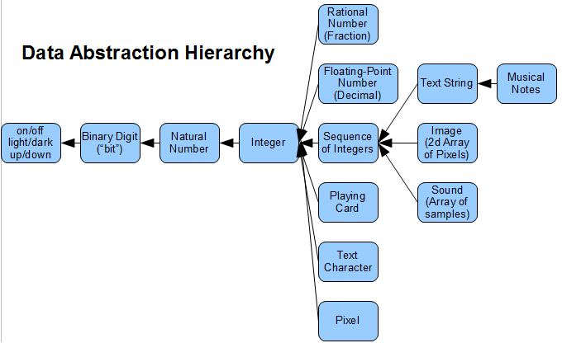
Data abstraction
Reduce details so programmer can focus on a few concepts at a time
Notes:
- Abstraction captures only those details about an object that are relevant to the current perspective
- Object is an attempt to combine abstractions of data and code
- Allows handling data bits in meaningful ways, i.e., it’s the basic motivation behind a datatype

Slide 7
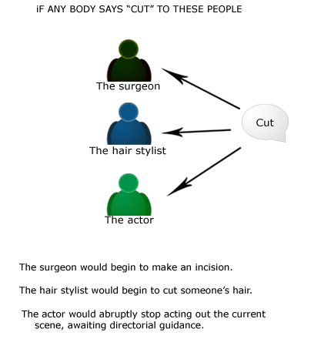
Polymorphism
No need to know specific type as long as type inherits shared ability

Slide 8
Polymorphism (2)
Allows values of different types to be “handled” using a uniform interface
Control
Button
ListBox
class Control {
public virtual void Draw() {
Console.WriteLine("Control");
}
}
class Button : Control {
public override void Draw() {
base.Draw();
Console.WriteLine("Button");
}
}
class TextBox : Control {
public override void Draw() {
Console.WriteLine("TextBox");
}
}
class Program {
static void Main(string[] args) {
Control[] controls = {
new Button(),
new TextBox()
};
foreach (Control c in controls) {
c.Draw();
}
}
}
Output
Control
Button
TextBox
Notes:
- Each individual control does the right thing according to its specific type
- In TextBox I don’t call the base method
- Virtual vs. abstract methods

Slide 9
Constructor
Method(s) that create instances of class
Called implicitly through new keyword
class Car {
string _make;
int _currentSpeed;
public Car() {
}
public Car(string make) {
_make = make;
}
public void SpeedUp(int delta) {
_currentSpeed += delta;
}
}
class Program {
static void Main(string[] args) {
Car c1 = new Car();
Car c2 = new Car("Kia");
c2.SpeedUp(10);
}
}
Notes:
- ctor is always named by name of class
- If you don’t provide a ctor, a default one is provided (see ILSply)
- Default ctor takes no arguments - Overload ctor to take arguments
- Data is set to default value as part of object construction and before ctor code executes - bool is false, ref is null, int is 0, float is 0.0
- Provide custom ctor to set state at construction time
- Naming convenion with _ to avoid scope ambiguity

Slide 10
this keyword
Provides explicit access to instance data
this keyword is implicitly implied
Used for constructor chaining as well
class Car {
string make;
int currentSpeed;
public Car() : this("Kia") {
}
public Car(string make) {
this.make = make;
}
public void SpeedUp(int delta) {
this.currentSpeed += delta;
}
}
Notes:
- this resolves ambiguity with member resolution
- Example: with ”this.make” it resolves ambiguity. For Speedup method it doesn’t add anything
- I hardly ever use this as it adds noise to the code
- Use optional arguments with ctor as alternative to ctor chaining for >= .NET version 4.0

Slide 11
Access modifiers
Controls visibility of types and members to other types, members, and assemblies
Makes encapsulation possible
Common modifiers
public
private
protected
// internal class with private constructor
class Radio {
Radio() {
}
}
// public class with public constructor
public class Radio {
public Radio() {
}
}
// protected member accessible in derived class
public class Radio {
string _model;
public string GetModel() { return _model; }
protected void SetModel(string model) {
_model = model; }
}
public class DABRadio : Radio {
public DABRadio() {
SetModel("DAB");
}
}
Notes:
- Without access modifiers, encapsulation wouldn’t be achivable and we’d only have OO as a grouping mechanism
- Example - Types are internal by default - Type members private by default

Slide 12
Properties
Short-hand accessor and mutator methods
Supports read-only or write-only properties
Automatic properties remove boilerplate code
Automatic properties always implement both read and write
public class Person {
string _name;
public string GetName() {
return _name; }
public void SetName(string name) {
_name = name; }
}
public class Person {
string _name;
public string Name {
get { return _name; }
set { _name = value; }
}
}
public class Person {
public string Name { get; set; }
}
Notes:
- Implemented as accessor and mutator methods in CIL (verify with ILSpy)
- Removes boilerplate code as many properties have no associated logic
- value within mutator is a special token provided by the compiler
- Oftentimes validation logic is added to set
- Name of backing field is invalid in C# but valid in CIL (prevents conflicts with C# code)
- Start with simple properties, then expand to hand-written ones when needed

Slide 13
Object initialization syntax
Class may not provide constructor to set value of all public fields or properties
Short-hand way to set values
public class Person {
public string Firstname { get; set; }
public string Lastname { get; set; }
}
class Program {
static void Main(string[] args) {
Person p = new Person();
p.Firstname = "John";
p.Lastname = "Doe";
}
}
class Program {
static void Main(string[] args) {
Person p = new Person {
Firstname = "John",
Lastname = "Doe"
};
}
}
Notes:
- Removes boilerplate code
- Example - Default ctor is called, then the setter of each property
- Can be used with custom ctor as well

